Slide 1
Chapter 5
Responsive Design Part 1: Designing for Mobile Devices

Slide 2
Chapter Objectives
You will have mastered the material in this chapter when you can:
Explain the principles of responsive design
Describe the pros and cons of a mobile website
Explain the design principles of a mobile website
Describe a mobile-first strategy
Define a viewport
Insert a meta viewport element

Slide 3
Chapter Objectives (continued)
Use a mobile simulator
Create a sticky element
Integrate custom fonts
Use a pseudo-class
Create a mobile-friendly navigation system
Add a telephone link
Make rounded corners

Slide 4
Introduction
Responsive design is a website development strategy that strives to provide an optimal user experience of a website regardless of the device used
By applying responsive design principles, the webpage and content respond to the screen size of the user’s device
Minimizes unnecessary scrolling and zooming, making reading and interacting with the site as convenient and intuitive as possible

Slide 5
Project — Redesign a Website for Mobile Devices
Roadmap
ADD a META VIEWPORT ELEMENT to each HTML document
CREATE a STICKY HEADER
ADD CUSTOM FONTS
STYLE PAGES FOR a MOBILE VIEWPORT
STYLE the MAP FOR a MOBILE VIEWPORT

Slide 6
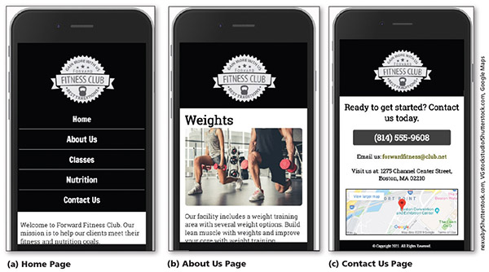
Project — Redesign a Website for Mobile Devices (continued)
Figure 5–1

Slide 7
Exploring Responsive Design
Content is easy to read and navigate on devices of three sizes: desktop browser, tablet, and phone
Philosophy that is constantly refined as HTML and CSS standards, browsers, and technology evolve and improve

Slide 8
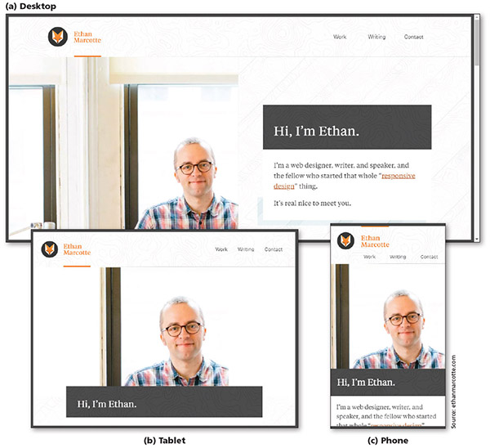
Exploring Responsive Design (continued 1)
Figure 5–2

Slide 9
Exploring Responsive Design (continued 2)
Fluid layout
Applies proportional size measurements to the webpage wireframe and content
The viewport is the viewing area for the webpage; refers to the area of the webpage that a user sees at any one time, regardless of device, browser, screen size, screen resolution, window size, or orientation

Slide 10
Exploring Responsive Design (continued 3)
Responsive or flexible images
Shrink and grow based on the size of the viewport
Do not have height and width attributes or values in the HTML document
Use CSS rules to resize the image relative to the wireframe and viewport

Slide 11
Exploring Responsive Design (continued 4)
Media queries
Allow the webpage developer to detect the approximate pixel size of the current viewport
Allow the developer to selectively apply CSS rules that work best for that viewport size

Slide 12
Designing for Mobile Devices
Mobile website
Completely separate, parallel website optimized for mobile users to address problems with viewports
Identified with an m. or mo. prefix in the URL
Optimizes the viewing experience for a wide range of devices using one website
Major downside: multiplies the work required to maintain what becomes two separate websites for the same organization

Slide 13
Designing for Mobile Devices (continued 1)
Mobile-first strategy
Employs responsive design principles
Web developer designs the flexible wireframe and essential content for the smallest viewport first, progressively adding more content as the viewport grows
Media queries are used to add styles for progressively larger viewports, progressing from tablet to laptop and desktop
More productive and effective way to build a website from scratch

Slide 14
Designing for Mobile Devices (continued 2)
Implementation of the website development approach depends on many factors
Current environment
Target audience
Available resources
Time available to tackle the project

Slide 15
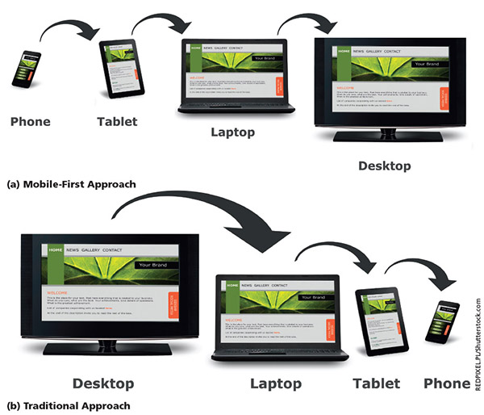
Designing for Mobile Devices (continued 3)
Figure 5–3

Slide 16
Using Responsive Design
Webpage with a fluid layout adjusts the webpage design and content based on the size of the viewport
Responsive designs are based on fluid layouts
Fixed layouts do not change in width based on the size of the viewport
Use fixed measurement units such as pixels to define the width of the areas of the wireframe that “fix” the width of the content regardless of the size of the viewport

Slide 17
Creating a Fluid Layout
A fluid layout requires a fluid grid, media queries, and responsive images
To create a fluid grid, you design a webpage that uses a grid or columns
A mobile viewport should use a single-column design, which is ideal for a smaller viewport
As the viewport’s size increases, the number of columns can also increase

Slide 18
Following a Mobile-First Strategy
It is better to use a single-column layout for a mobile display as this prevents scrolling horizontally
Displaying what mobile device users need and want on a single screen with minimal scrolling creates a more enjoyable experience
Styling content for mobile devices requires that each page be analyzed
Determine the most important content on the page and style that content

Slide 19
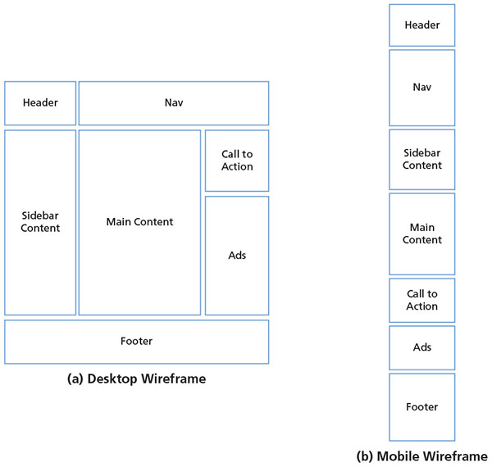
Following a Mobile-First Strategy (continued 1)
Figure 5–8

Slide 20
Following a Mobile-First Strategy (continued 2)
Some key practices when designing for mobile viewports
Make use of 100% of the screen space
Design the navigation to be easy and intuitive
Keep load times minimal
Display essential page content and hide nonessential page content
Make the content easy to access and read
Design a simple layout

Slide 21
Following a Mobile-First Strategy (continued 3)
When creating a website with a responsive design, a meta viewport element must be included within every HTML file
Provides the browser with information about the page’s dimensions and how to adjust scaling on the webpage
A mobile simulator displays an example of how a website would appear on a mobile device
Many available online

Slide 22
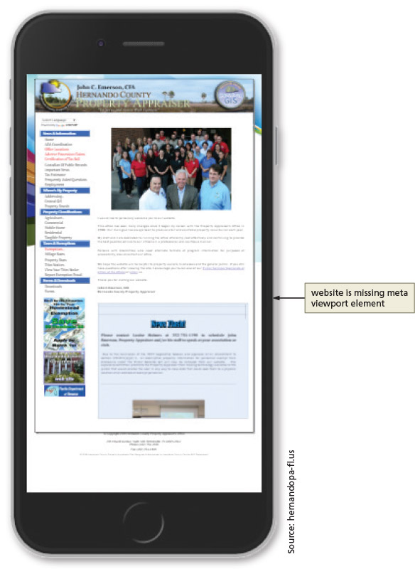
Following a Mobile-First Strategy (continued 4)
Figure 5–10

Slide 23
Following a Mobile-First Strategy (continued 5)
Steps in a mobile-first strategy
First, analyze each page to determine the most essential content and whether to hide some of the content on a mobile device
Depending on the design, you may want the company name or logo to remain at the top of the webpage as the user scrolls down
To accomplish this task, you create a fixed or sticky header, known as a sticky element

Slide 24
Following a Mobile-First Strategy (continued 6)
The navigation system for a website can look different in each viewport
Many mobile viewport designs use a hamburger button or icon to display or toggle a navigation system
Typography is a design element to consider when designing a website
Today, many custom fonts can be used by downloading them onto web servers or by linking to them in HTML files

Slide 25
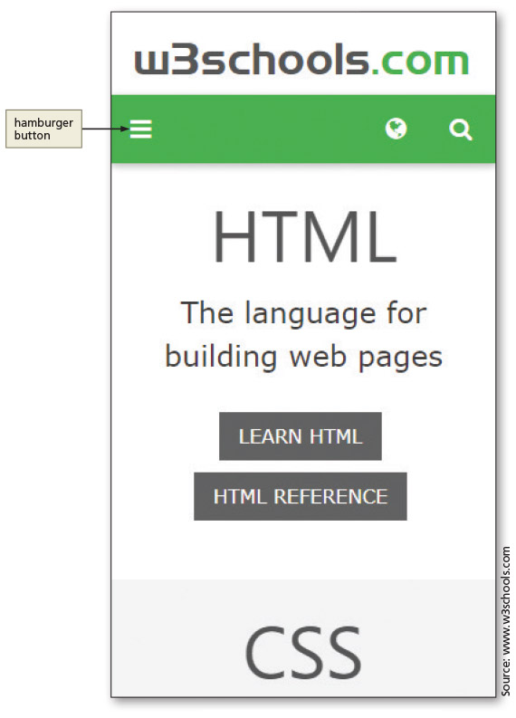
Following a Mobile-First Strategy (continued 7)
Figure 5–21

Slide 26
Following a Mobile-First Strategy (continued 8)
A pseudo-class can be used with a selector to specify the state of an element
For example, you can specify a style to apply when a mouse hovers over an element
Essential information can be added to the home page without removing the content for webpage visitors with a desktop device
The div element is used to accomplish this task

Slide 27
Following a Mobile-First Strategy (continued 9)
By default, element borders use a 90-degree angle at each corner
You can see the angle when you specify a border all around an element
Images also have a default 90-degree angle at each corner
Change default appearance by applying rounded corners with CSS
CSS property to round corners is border-radius

Slide 28
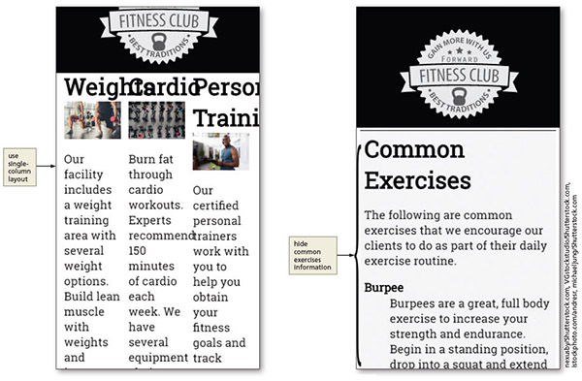
Analyze the About Us Page for Mobile-First Design
Figure 5–52

Slide 29
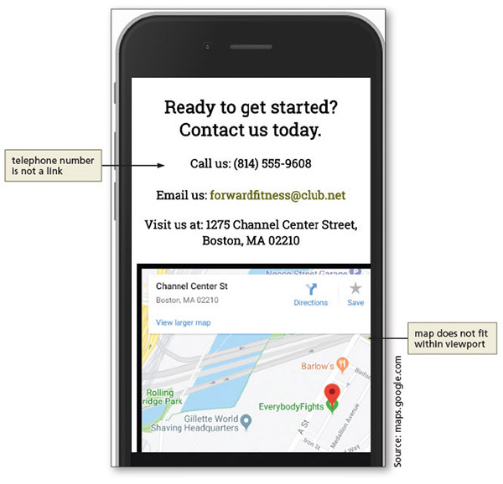
Analyze the Contact Us Page for Mobile-First Design
Figure 5–58

Slide 30
Mobile-Friendly Test
Once you have completed your design for a mobile viewport, view and test it on as many smartphone devices as possible
Google Chrome’s device mode is helpful during the design process
Testing on an actual device is optimal

Slide 31
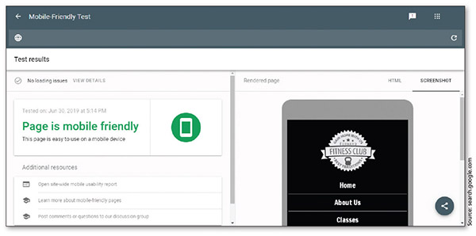
Mobile-Friendly Test (continued)
Figure 5–63

Slide 32
Chapter Summary
In this chapter, you learned how to apply responsive design principles to a website
Modified the fitness website to use a fluid layout
Added a meta viewport element
Followed a mobile-first strategy to analyze and modify the webpages in the fitness website
Integrated custom fonts
Created a sticky element and a responsive navigation system for a mobile viewport
Used a pseudo-class
Added rounded corners

